Slide 1
Electric Vehicle ETL Project
We Got No Gas
Beth Gietl
Lori Fraunfelder
Ce’Aren Robinson
Rob Thompson
Lynn Pettis

Slide 2
01
Project Outline
02
Extract / Locating the Data Sources
Locating the original data sources and how the data was formatted (CSV, JSON, pgAdmin 4, etc).
03
Transform / Data Cleanup & Analysis
Cleaned and transformed the data for analysis.
04
Load
CONTENTS
Join data sources into the final database with tables/collections.
05
Project Summary

Slide 3
Project Outline:
We looked at two Electric Vehicle (EV) data sources.
Downloaded CSV file from Kaggle.com
Scraped an HTML article from CarAndDriver.com
We examined and compared the data from the two sources. The sources had similar data; make, model, range, etc.
They also carried unique values separately and through the ETL process we joined the two data sources together to enhance the analysis.

Slide 4
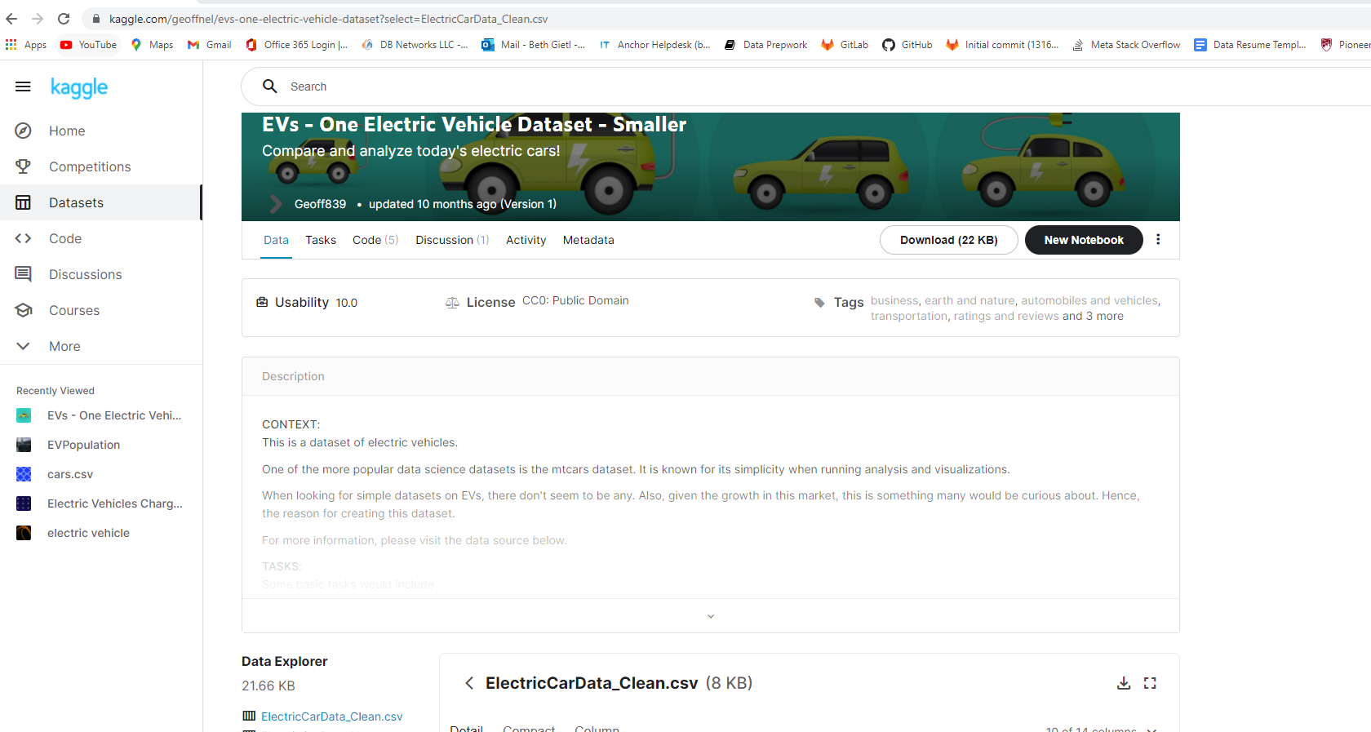

Extract: First Data Source, CSV file

Slide 5
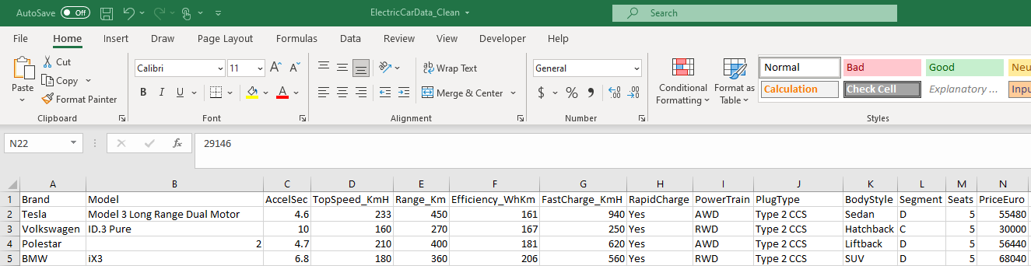
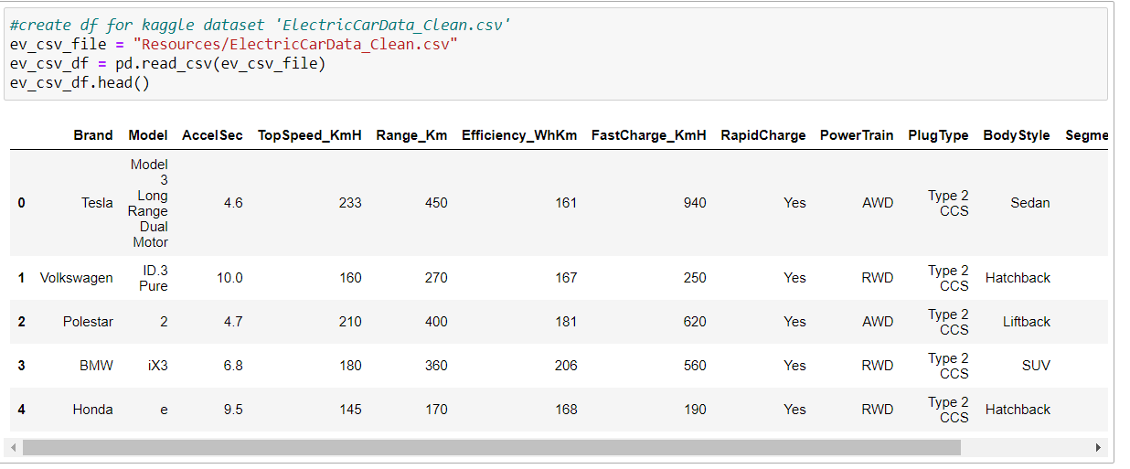
Extract: CSV file to Pandas

Slide 6
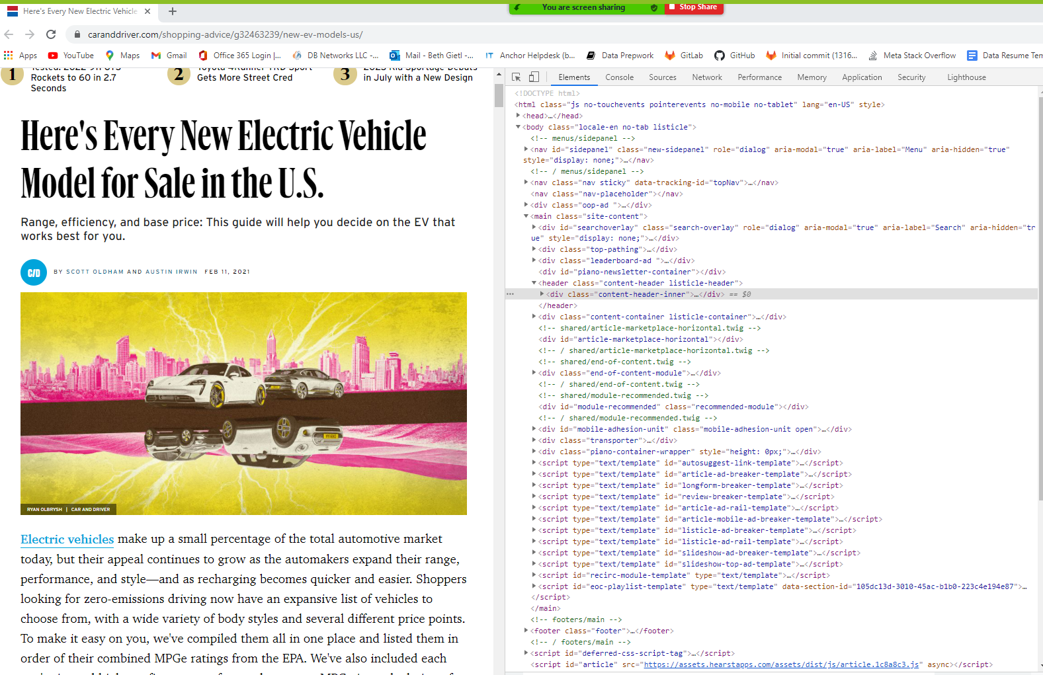
Extract: Second Data Source, HTML Article

Slide 7
Extract: HTML to JSON
Scraped the HTML to JSON.
The code did not have unique identifiers

Slide 8
Extract: HTML to JSON
Second Source of Data:
Located EV data in the html article: “Here's Every New Electric Vehicle Model for Sale in the U.S.”
JSON
JSONIFY
Load into SQL and created a dataframe

Slide 9
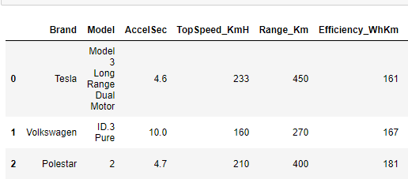
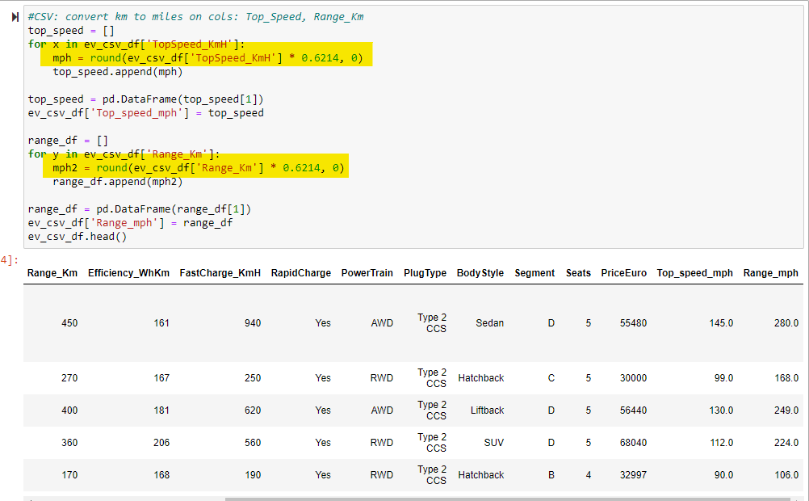
Transform: CSV file
Using Pandas we converted the Kilometers per hour in the Top Speed and Range columns to Miles per hour.

Slide 10
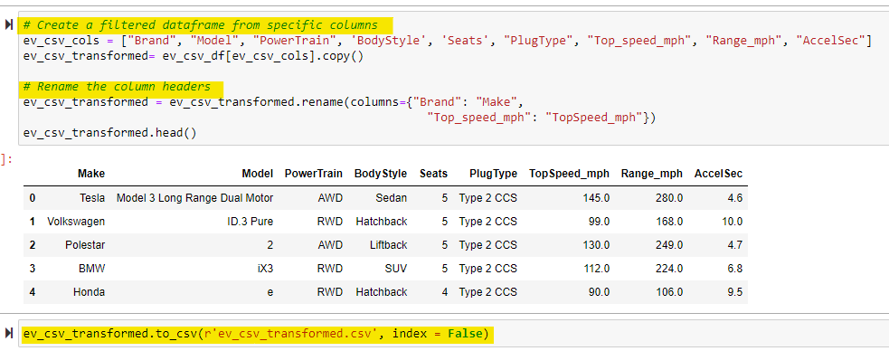
Transform: CSV file
Using Pandas we transformed the CSV file:
Created a filtered dataframe and dropped unnecessary columns
Renamed column headers
Read and Saved the dataframe to a new CSV file

Slide 11
Finding Data / Extract
In this project we found datasets from the following sources
First Source of Data:
Extracted the ElectricCarData_Clean.csv from Kaggle.com
Imported the csv file to python and created a dataframe.
Second Source of Data:
Located EV data in the html article: “Here's Every New Electric Vehicle Model for Sale in the U.S.”
JSON
JSONIFY
Load into python and created a dataframe

Slide 12
Transform
CSV File:
Kilometers per hour converted to Miles per hour…
Normalize the “model” column, split off the “trim” package and create new column.
Determined what data was not necessary for potential analysis. Drop columns:
Price, xx, xx, xx
Html file:
XX
XX
XX
pgAdmin:
Why Normalize data. by breaking down the csv data
Create different dataframes in pandas
Shrink

Slide 13
Extract: HTML to JSON

Slide 14
Extract: Scrape, Save and Render Data

Slide 15
Transform: JSONIFY

Slide 16
Load
Load: the final database, tables/collections, and why this was chosen.
Show or explain the pgAdmin/python connection
Show ERD
Show the final database
Show tables/collections

Slide 17
Load: Data Normalization
We used the Data normalization process to restructure data to a
set of “normal forms.”
First Normal Form (1NF):
Raw Data
1NF
Normalization
HOLD FOR PIC
HOLD FOR PIC
Second Normal Form (2NF):
Data in 1NF
Child Table
2NF Normalization
Family Table

Slide 18
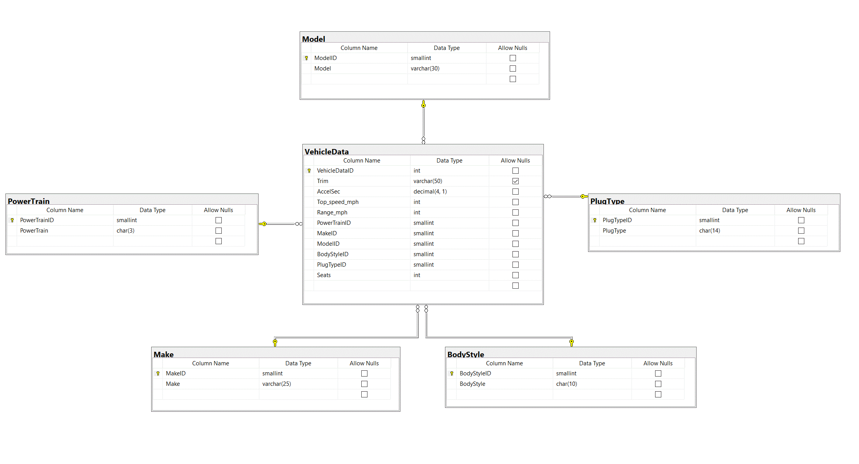
Load: Entity Relationship Diagram (ERD)
Our ERD provides a visual method of modeling the data.

Slide 19
Load: JSON and SQL

Slide 20
Sources
https://www.kaggle.com/geoffnel/evs-one-electric-vehicle-dataset?select=ElectricCarData_Clean.csv
https://www.caranddriver.com/shopping-advice/g32463239/new-ev-models-us/

Slide 21
THANK YOU

